Slide 1

RAJARAJESHWARI COLLEGE OF ENGINEERING
DEPARTMENT OF CIVIL ENGINEERING
PROJECT REVIEW ON
“EFFECTS OF IMPROPER BUS STOP LOCATIONS ON CAPACITY AND SPEED-FLOW LOCATION”

Slide 2
GUIDED BY
1) BHASKAR A N
Ass. Proff. Civil Dept
RRCE
PRESENTED BY
1) ANUSHKUMAR MG
(1RR17CV010)
2) DARSHAN R
(1RR17CV027)
3) MADHUSUDHAN R
(1RR17CV043)
4) KIRAN M
(1RR18CV412)

Slide 3
INTRODUCTION
The urban transportation is acting as a key to each economical communication in all urban over the world. The increase in urban population growth tends to increase vehicular growth and travel demand.
Typical urban transportation facilities include railways ,waterways ,airways and roadways. Among all categories ,the big proportion consist of roads.
Logically, most planning and research techniques are focused on road system. Many arterial roads exhibit deteriorated capacity and poor performance.

Slide 4
OBJECTIVES
To identify the deficiencies in existing bus stop locations.
To fix proper terminals and accessibility for public transportation system avoid congestion.
To reduce congestion at improper bus stop locations by reducing side friction.

Slide 5
METHODOLOGY
The following surveys has to conduct
Selection of study area
Identify the improper location of bus stops
Literature review
Analysis of data
Analysis of speed flow relation with
side friction
Analysis of speed flow relation
without side friction
Comparative conclusion effect of side friction

Slide 6
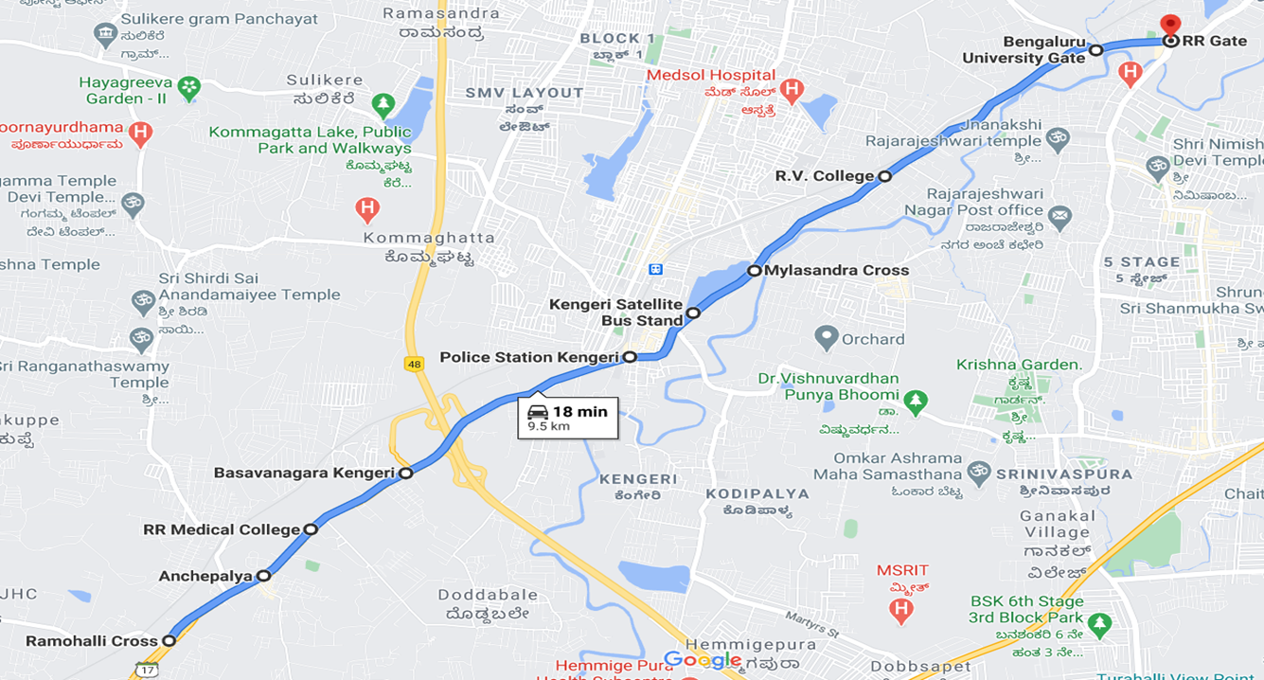
STUDY AREA SELECTION: The Location of study area is from Rajarajeshwari Dental college (Ramohalli Cross) to Rajarajeshwari Gate (Gopalan Mall).

Slide 7
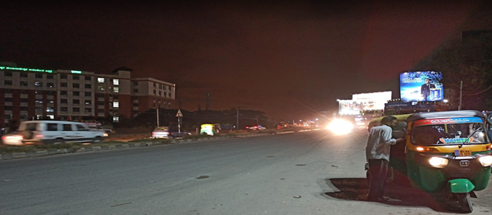
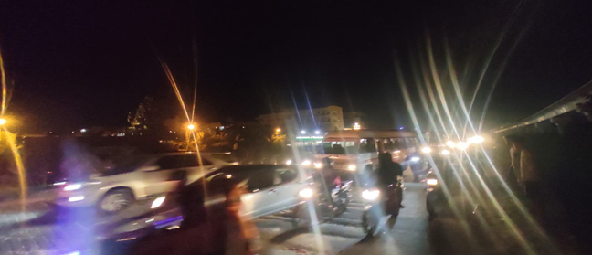
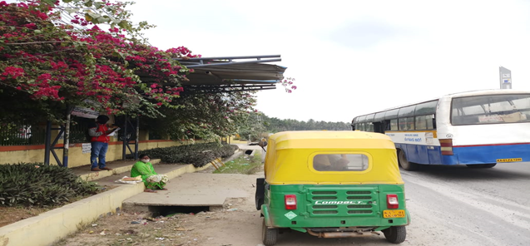
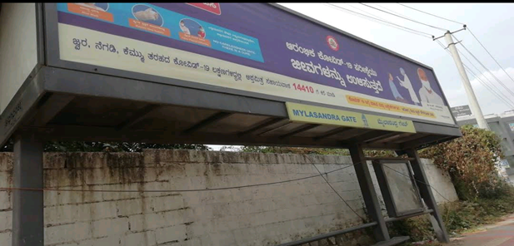
INVENTORY OF BUS STOPS Bus Stops on On-Road:When the Buses stops on the On Road Bus stops in order to board or alight the passengers, following vehicles are forced to slow down their speed due to decreased lane width. Location: Anchepalya, RRMCH and Check Post Bus Stop.
Bus Stop On Off Road : Bus Stops on off roads is where bus stops are given right next to the road, so that occurring of traffic congestion is less. The surface of the bus stops on off road is made of the mud along the road side. Location: Rajarajeshwari Dental College (Ramohalli Cross), Kengeri Police Station and Mylasandra Bus Stop.

Slide 8
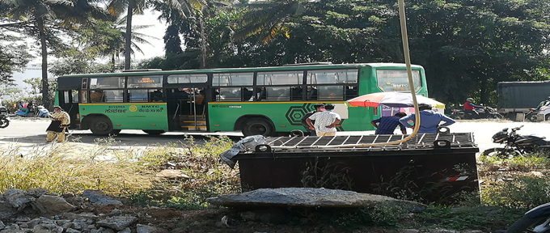
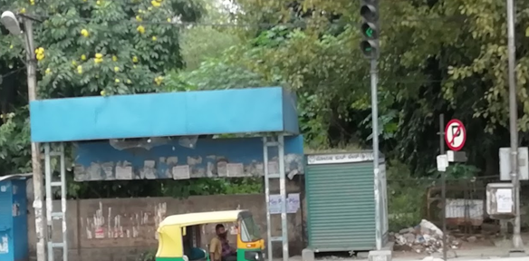
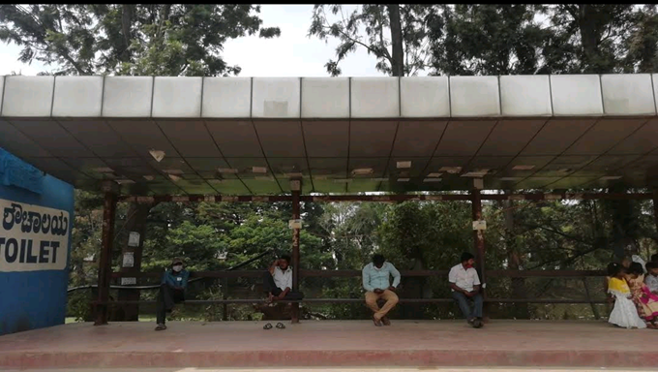
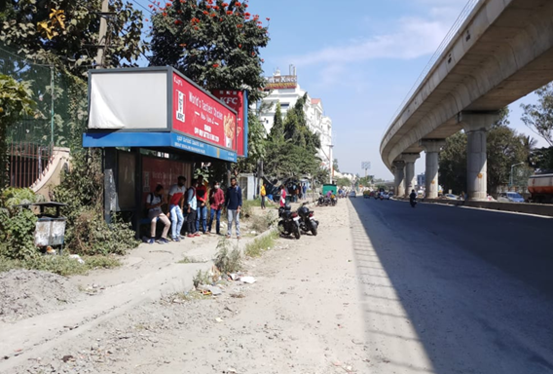
Bus Stops at the Junction: Bus stops near or at Junction again will be the main reason for the traffic congestion. It effects the traffic signal timings near the Junction. Location: Bangalore University Gate and Rajarajeshwari Arch (Gopalan Arcade Mall).
Bus Stops on Bus Bay: Bus Bay is a designated spot on the side of a road where buses may pull out of the traffic flow to pick up and drop off passengers.
Location: Kengeri Satellite (Depot) and R V College.

Slide 9
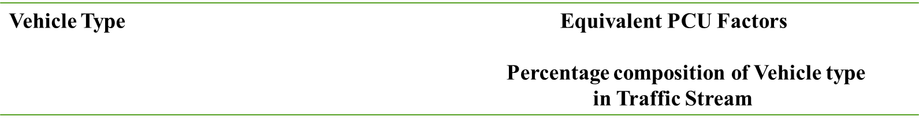
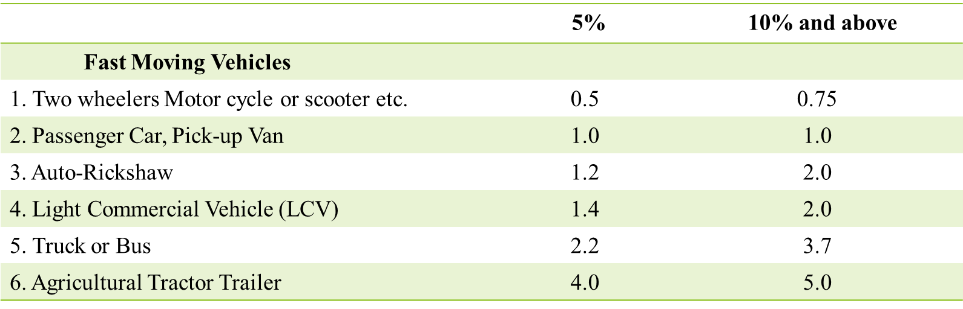
PCU Factors for Various Types of Vehicles on Urban Road As per IRC:106-1990

Slide 10
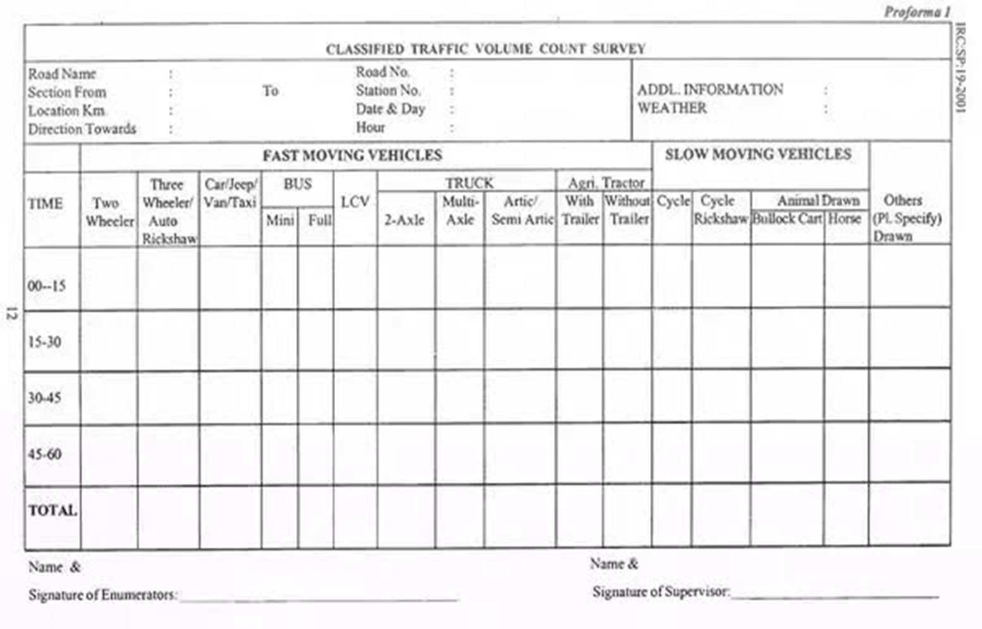

Slide 11
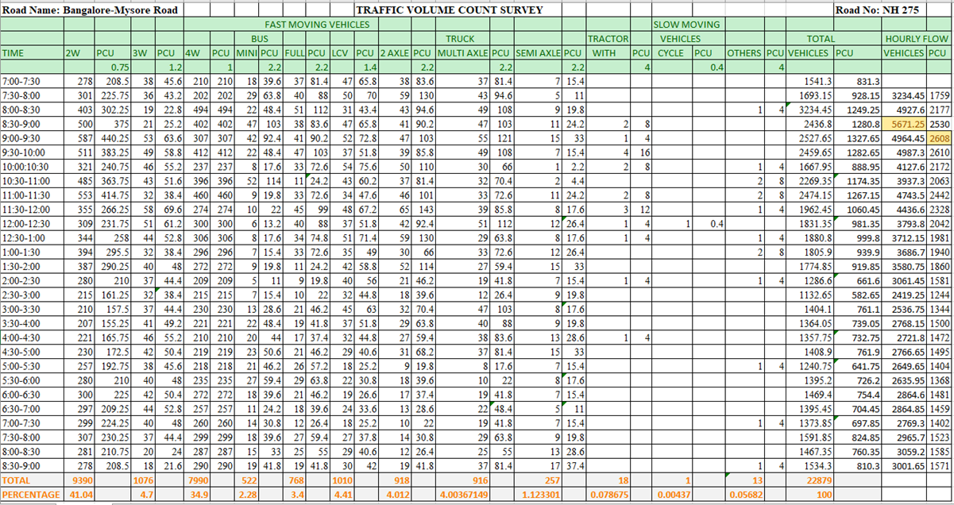

Slide 12
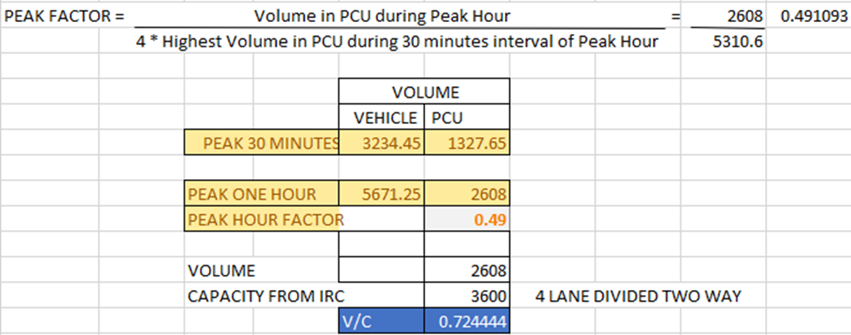

Slide 13
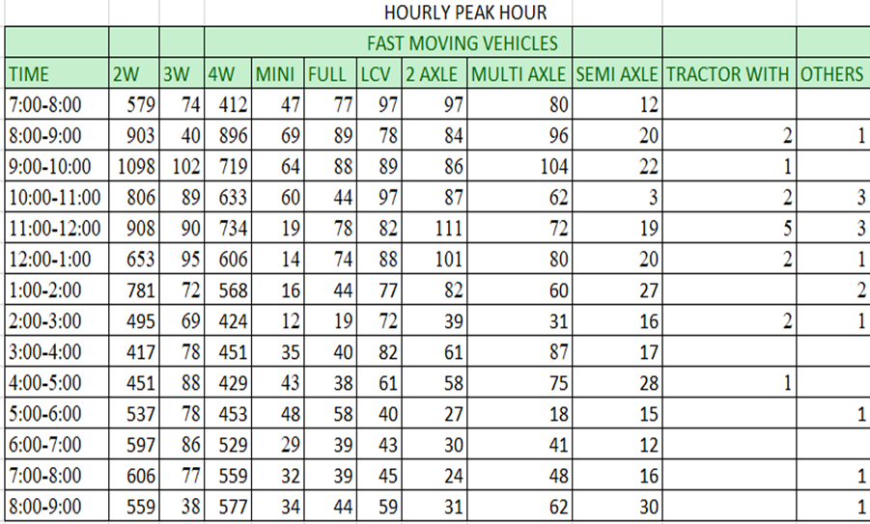
Traffic Survey Conducted by Us

Slide 14
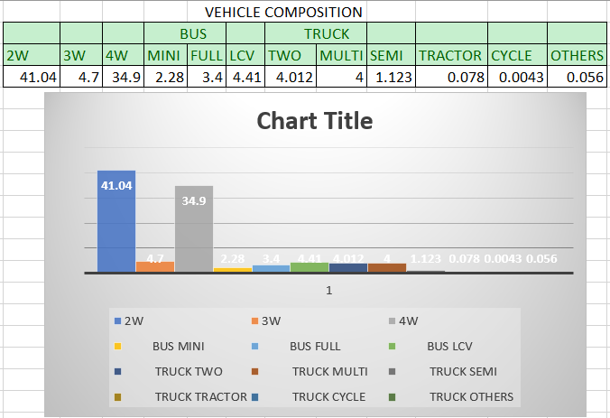
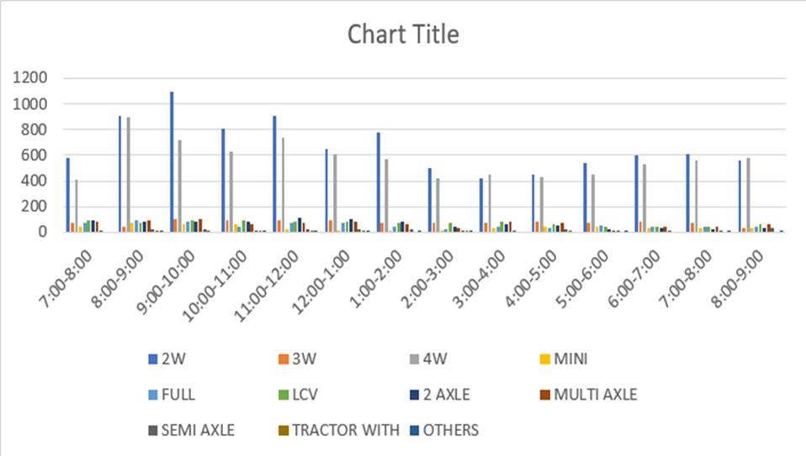

Slide 15
CONGESTION INDEX
Mathematically, Congestion index can be formulated as below
Congestion index = 1- (A/M)
Where,
A = Average journey speed observed on the stretch during peak period.
M = Desirable ideal average journey speed on the stretch during peak period, assumed as
40 kmph.

Slide 16
CALCULATION OF CONGESTION INDEX:
For the zone 1, i.e. From RRCE BUS STOP to KENGERI TTMC for the zone 2 from KENGERI TTMC to RAJARAJESHWARI NAGAR GATE, the values obtained for A and M are as follows and the congestion index is represented as a table and graph below
zones | A in kmph | M in kmph | Congestion Index
1 | 17.85 | 40 | 0.55
2 | 21.97 | 40 | 0.45

Slide 18
SIDE FRICTIONS
Vendors.
On road parking.
Improper bus stoppage.
Pedestrain crossing.

Slide 19
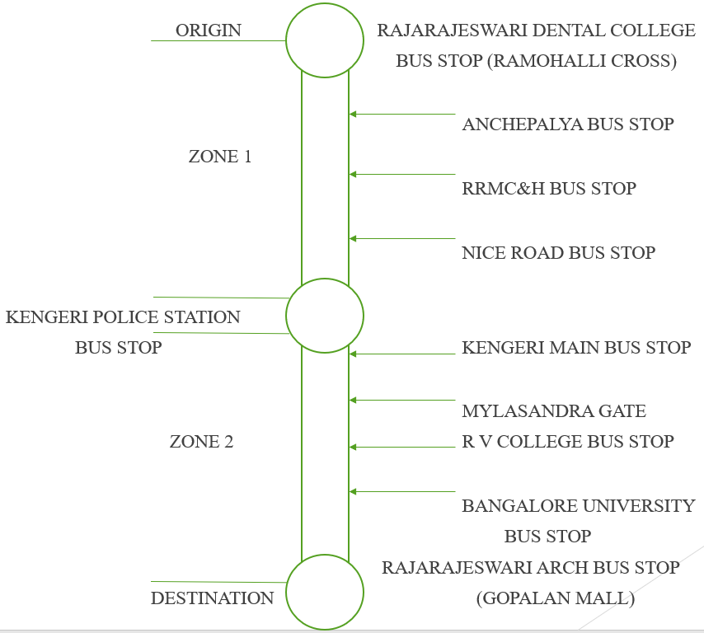
INVENTORY OF BUS STOPS

Slide 20
BUS STOP DETAILS
Sl No | Name of Bus Stops | Facility of Separate Bus Bay
 |  | YES | NO
1. | Ramohalli Cross (Rajarajeswari Dental College) |  | NO
2. | Anchepalya |  | NO
3. | Rajarajeswari Medical College and Hospital |  | NO
4. | Basavanagara Kengeri (Nice Road) |  | NO
5. | Police Station Kengeri |  | NO
6. | Kengeri Satellite (Depot) | YES
7. | Mylasandra Cross |  | NO
8. | R.V. College | YES
9. | Bangalore University Gate |  | NO
10. | Rajarajeswari Gate (Gopalan Mall) |  | NO

Slide 21
SPOT SPEED STUDY AT IDEAL BUS STOP (RV COLLEGE BUS STOP)
SPEED (m/s) | MID SPEED (m/s) | FREQUENCY (f) | FREQUENCY % | CUMULATIVE FREQUENCY %
0-5 | 2.5 | 7 | 9.33 | 9.33
5-10 | 7.5 | 56 | 74.66 | 83.99
10-15 | 12.5 | 12 | 16 | 99.99

Slide 22
SPEED FLOW AT RV COLLEGE BUS STOP
SPEED
m/s
FLOW

Slide 23
MODAL SPEED AT RV COLLEGE BUS STOPS
FREQUENCY
%
SPEED m/s

Slide 24
SPOT SPEED AT IDEAL BUS STOP (KENGERI TTMC BUS STOP)
Speed(m/s) | Mid speed(m/s) | Frequency(f) | Frequency(%) | Cumulative frequency %
1-5 | 3 | 4 | 12.5 | 12.5
6-10 | 8 | 25 | 78.13 | 90.63
11-15 | 13 | 3 | 9.37 | 100

Slide 25
SPEED FLOW AT KENGERI TTMC
Speed m/s
Flow

Slide 26
MODAL SPEED AT NEAR KENGERI TTMC
FREQUENCY
%
Speed m/s

Slide 27
SPOT SPEED AT NON IDEAL BUS STOP KENGERI POLICE STATION
Speed(m/s) | Mid speed(m/s) | Frequency(f) | Frequency(%) | Cumulative frequency %
0-4 | 2 | 16 | 22.53 | 22.53
4-8 | 6 | 54 | 76.06 | 98.59
8-12 | 10 | 1 | 1.42 | 100

Slide 28
SPEED FLOW AT NON IDEAL BUS STOPS ( KENGERI POLICE STATION )
Speed m/s
Flow

Slide 29
MODAL SPEED AT KENGERI POLICE STATION
FREQUENCY
%
Speed m/s

Slide 30
SPOT SPEED AT NON IDEAL BUS STOP (BANGALORE UNIVERSITY)
Speed(m/s) | Mid speed(m/s) | Frequency(f) | Frequency(%) | Cumulative frequency %
0-2 | 1 | 2 | 3.92 | 3.92
2-4 | 3 | 31 | 60.78 | 64.7
4-6 | 5 | 17 | 33.33 | 98.03
6-8 | 7 | 1 | 1.96 | 99.99

Slide 31
SPEED FLOW AT BANGALORE UNIVERSITY
Speed m/s
Flow

Slide 32
MODAL SPEED AT BANGALORE UNIVERSITY
3.5 m/s
Frequency
%
Speed m/s

Slide 33
Comparison between ideal bus stops and other bus stops
KENGERI TTMC BUS STOPS
KENGERI POLICE STATION

Slide 34
RV COLLEGE BUS STOP
BANGALORE UNIVERSITY

Slide 35
RESULTS
The modal speed at KENGERI TTMC BUS STOP (ideal bus stop) is 8.5 m/s
The model speed at KENGERI POLICE STATION (non ideal bus stop) is 6 m/s
The model speed at RV COLLEGE BUS STOP (ideal bus stop) is 8 m/s
The model speed at BANGALORE UNIVERSITY stop is 3.5 m/s

Slide 36
CONCLUSION
From the analysis of data we can judge that on-street bus stops will interfere with vehicle movement if bus demands exceeds the bus stop capacity,resulting in some buses queuing and congestion.
All the bus stops are on- street bus stops which are heavily congested during peak hour
To overcome the prombles we are suggesting following proposals;
Providing proper bus bay of suitable design
On-street parking should be restricted on both opposite side bus stops.

Slide 37
THANK YOU

